Slide 1


Flight Management System
Team Members:
1.Gangothri
2.Ojas Tyagi
3.Ruchi Binayake
4.Srivardan Patel

Slide 2
Introduction
The Flight Management System is a cutting-edge , Java –based booking solution designed to simplify the process of booking and managing flight tickets.
With its real-time consolidation of data from multiple airline carriers ,the time system provides users with accurate and up-to-data information on available flights , routes .
This intuitive and user friendly application empowers travelers to make informed decisions about their travel plans ,while also streamlining the management of booking for administrators.
The Flight Management System is a cutting-edge , Java –based booking solution designed to simplify the process of booking and managing flight tickets.
With its real-time consolidation of data from multiple airline carriers ,the time system provides users with accurate and up-to-data information on available flights , routes .
This intuitive and user friendly application empowers travelers to make informed decisions about their travel plans ,while also streamlining the management of booking for administrators.

Slide 3
Software Requirements
FrontEnd:
DataBase:
BackEnd:
HTML
CSS
JavaServerPages
(Jsp)
Java Script
Java
Spring Data Jpa
Spring Boot
Spring Security
My SQL

Slide 4
Project Overview
Admin Features:
Customer Features:
Create a New Account.
Login with username and password.
View Airports, Flights, and Routes.
Book a flight by selecting a flight and passenger details.
Search for Available Flights by source and destination.
Cancel the Flight if necessary.
Create a New Account.
Login with username and password.
Add and View Airports, Flights, and Routes details.
Book Flight
Modify Airports, Flights, and Routes.
View Passengers Details
View Tickets Bookings

Slide 5
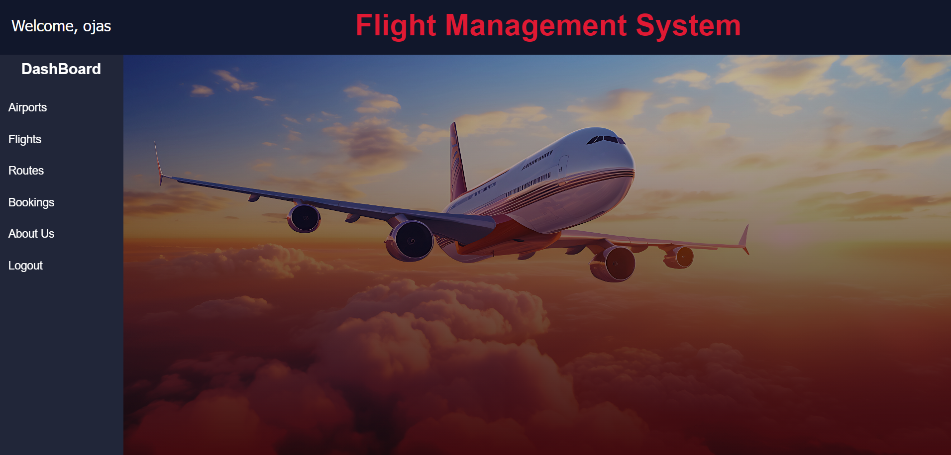
For easy navigation, this flight management system considers a proper dashboard for the Admin and the Customer. There are different dashboards based on user type either Admin or Customer with different privileges.
DASHBOARD

Slide 6
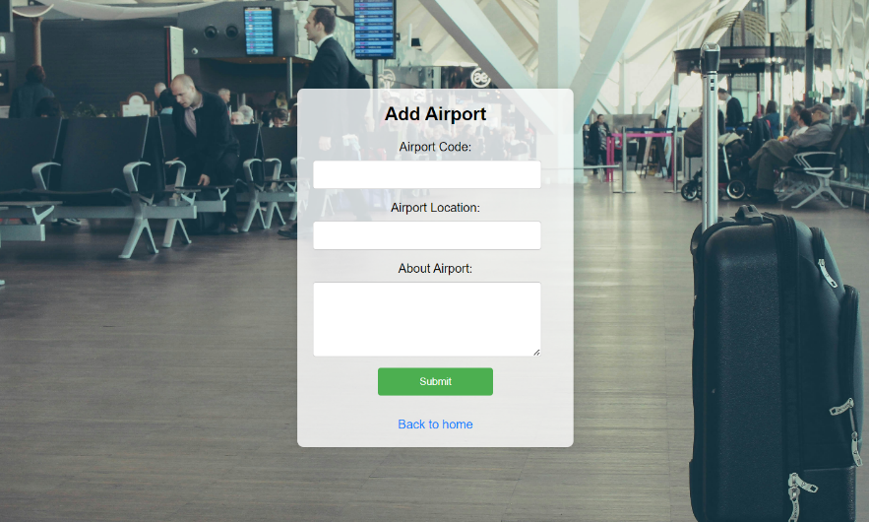
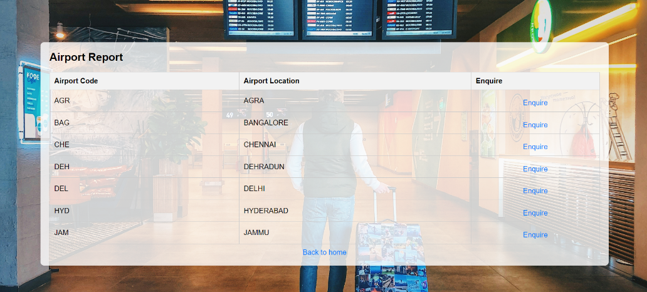

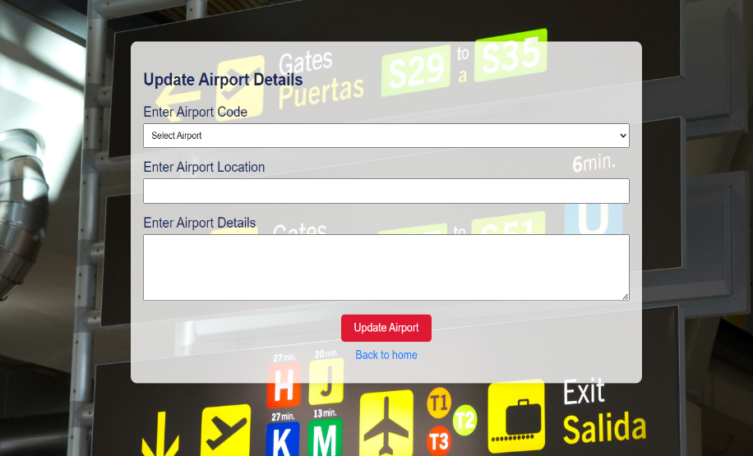
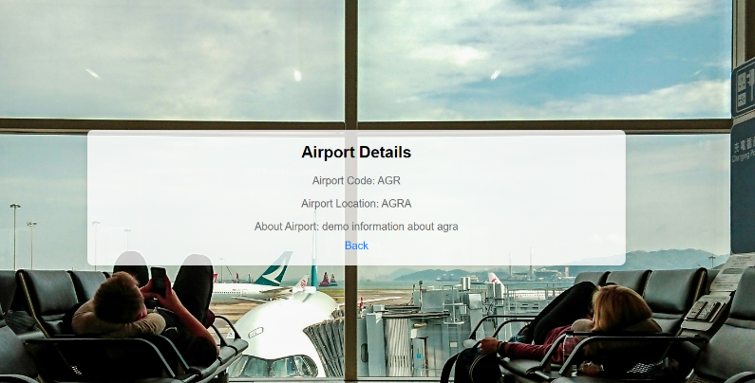
AIRPORT PAGE
Airport Report
Add Airport
Modify Airport
Airport Details

Slide 7
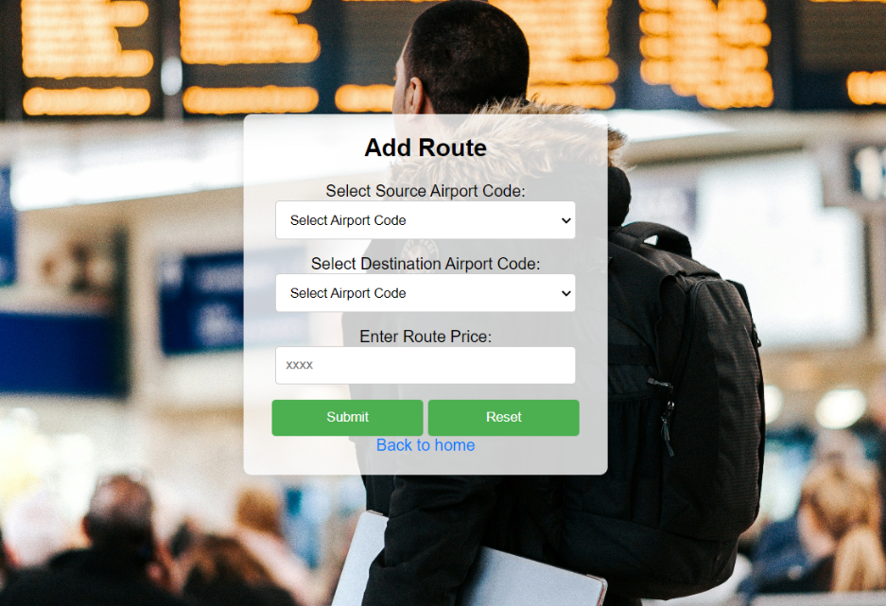
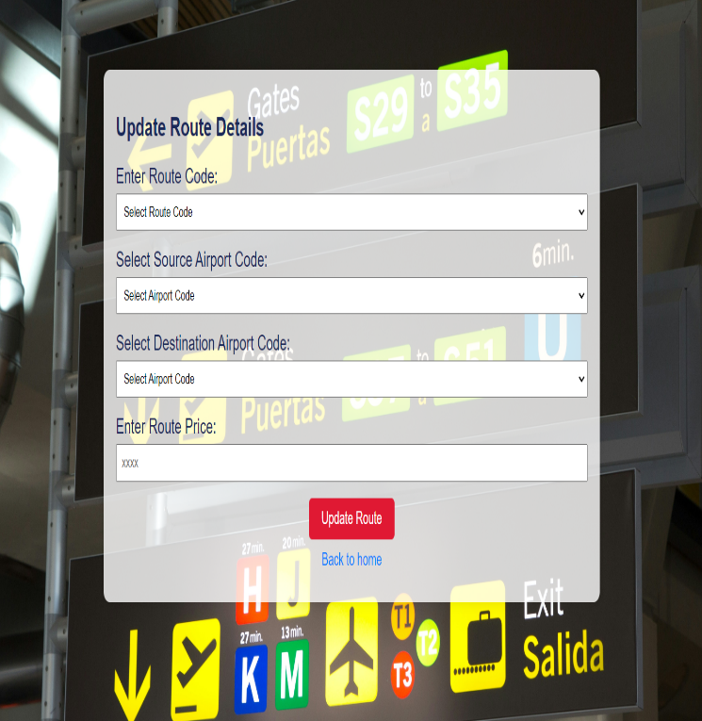
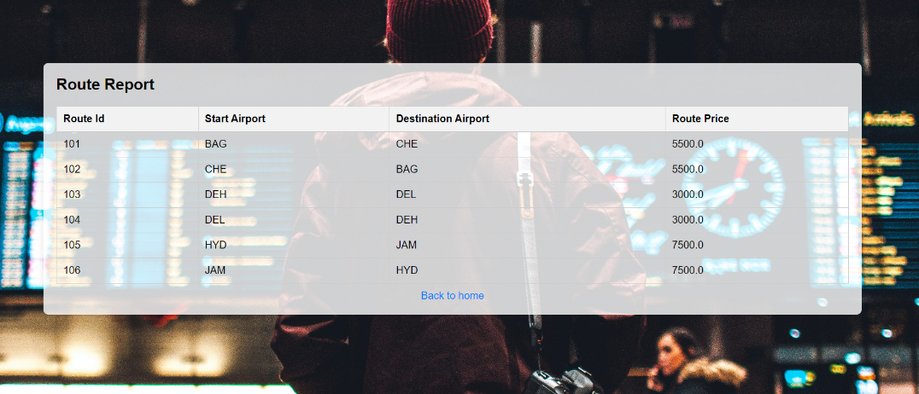
ROUTE PAGE
Add Route
Route Details
Modify Route

Slide 8
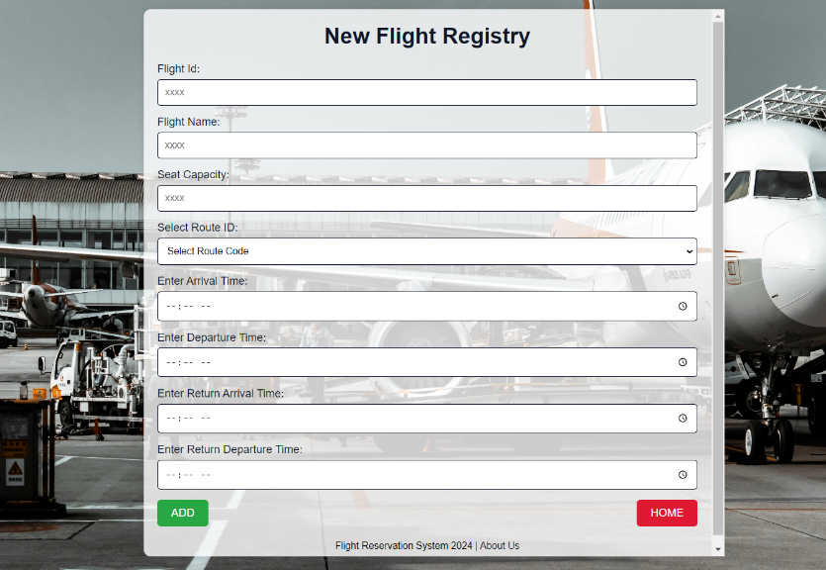
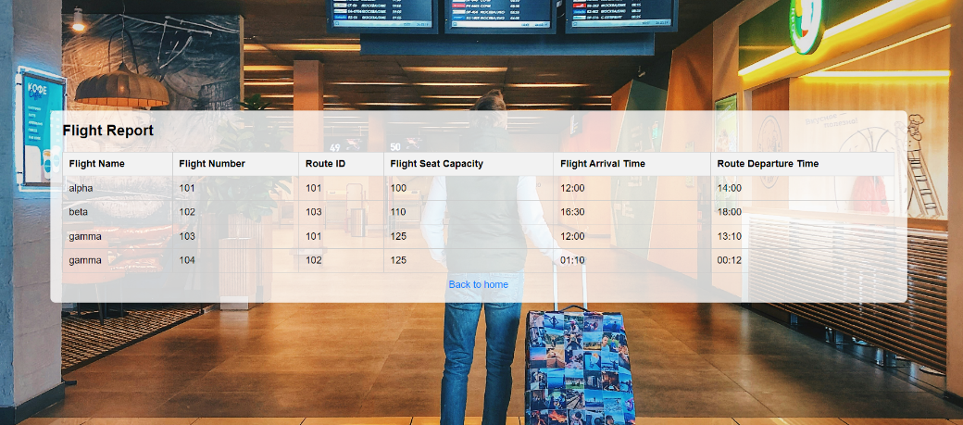
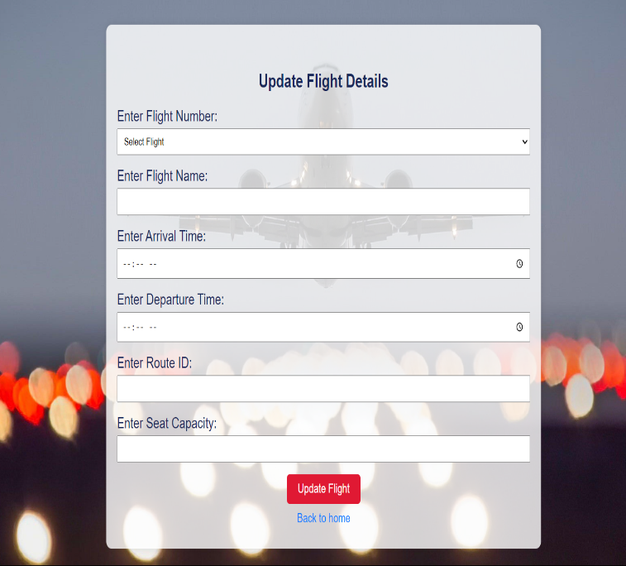
FLIGHT PAGE
Add New Flights
View Flight Details
Modify Flight

Slide 9
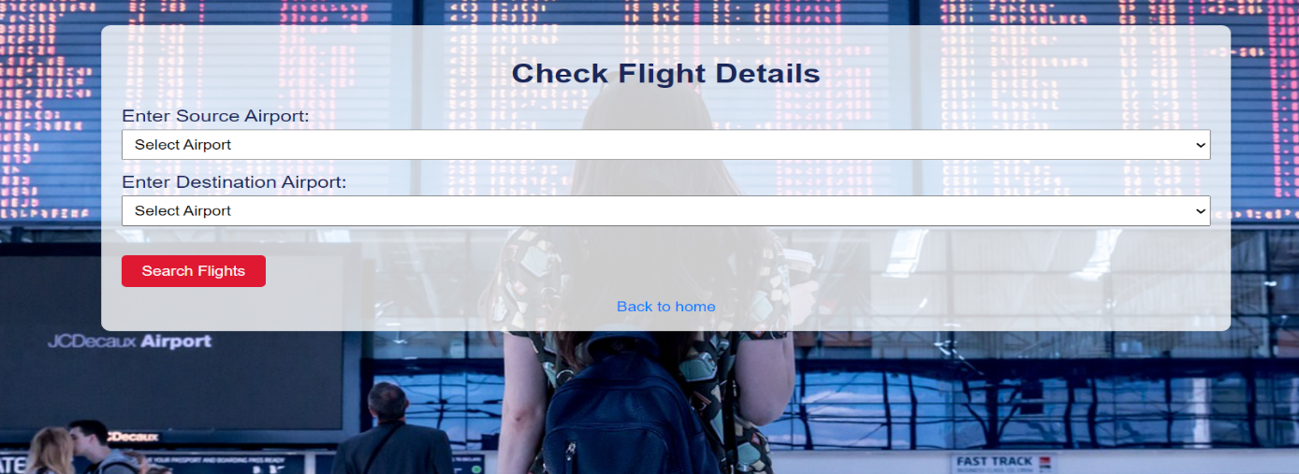
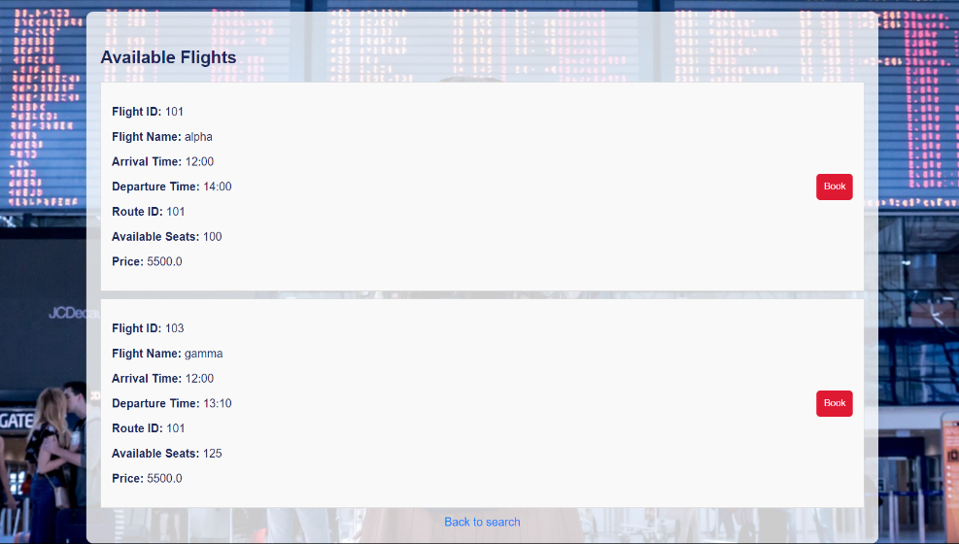
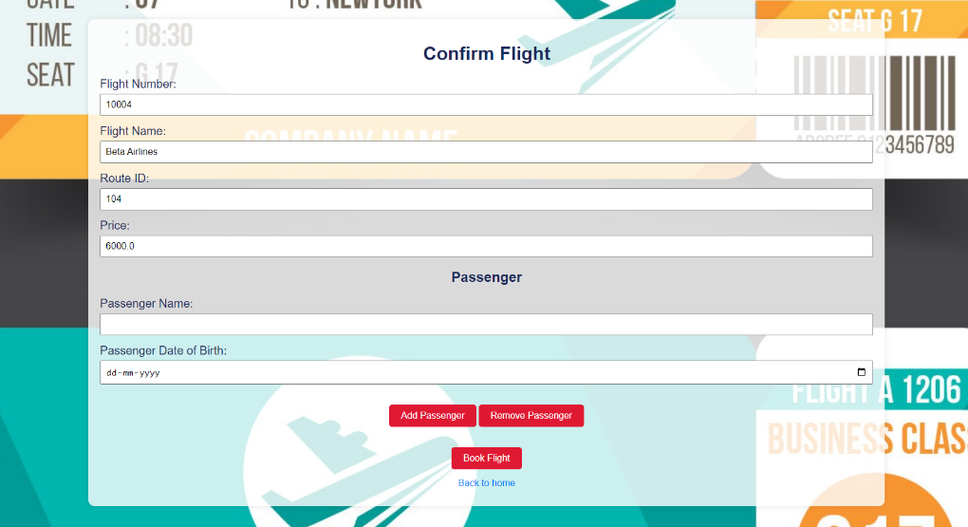
BOOKING PAGE
Check Flight Details
Available Flights
Add Passenger Details

Slide 10
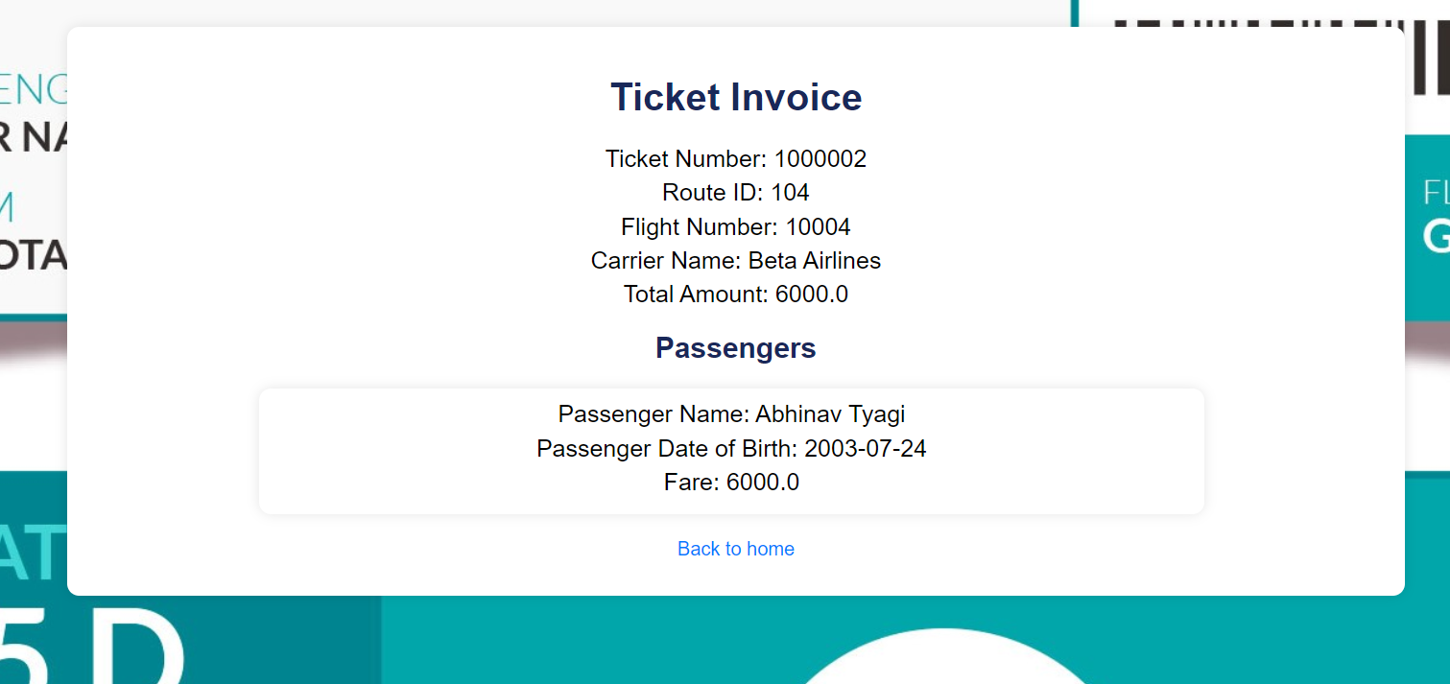
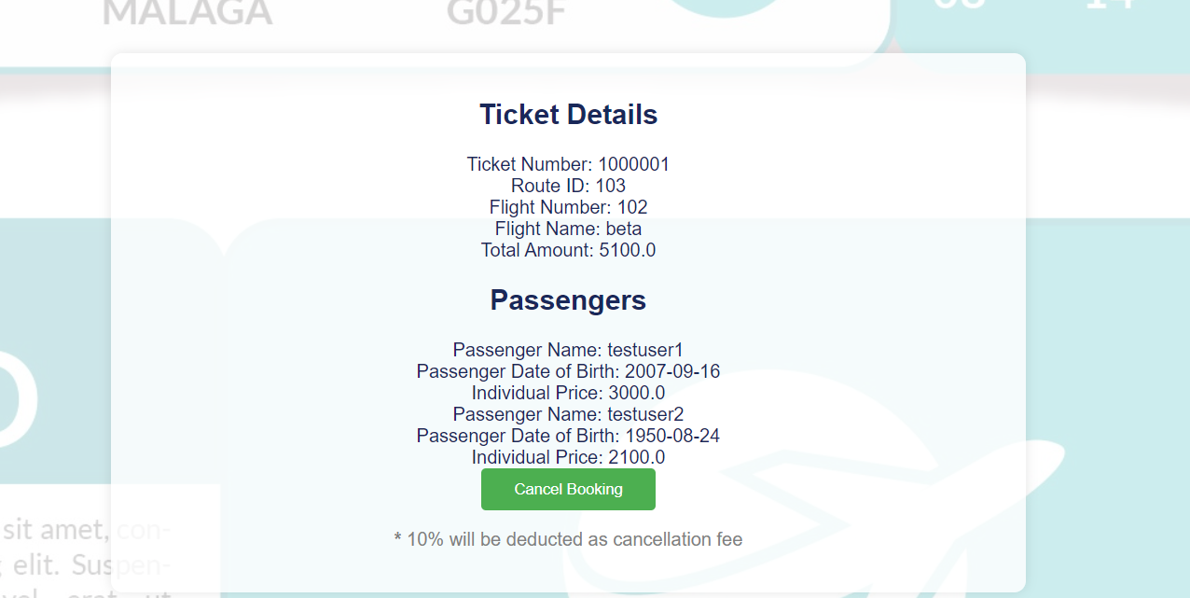
TICKET INVOICE
These pages will allow the customer to view their bookings and cancel any ticket if required the cancellation work is based on entering the ticket number.

Slide 11
Conclusion
In conclusion, our Flight Management System project has successfully met its objectives, providing a comprehensive and user-friendly platform for managing flight bookings, user accounts, airport information, and routes. Throughout the project, we implemented several key functionalities, including the addition and viewing of flights, users, airports, and routes, as well as the ability to edit existing records.
We have also integrated robust exception-handling mechanisms to ensure the system's reliability and user-friendly error messaging. This has enhanced the overall user experience and system stability.
Our dynamic passenger addition feature allows users to book flights for multiple passengers seamlessly, and the seat booking system ensures accurate tracking and updating of available seats. The system's capability to dynamically calculate ticket prices based on passenger age and apply appropriate discounts demonstrates its flexibility and attention to user needs.
The development process has been an excellent learning experience, providing valuable insights into Java Spring Boot, JSP, and various web development technologies.

Slide 12


